Slide 1
SuperOffice Mobile CRM how to install
How to do
Gunnar Peren CRM Manager

Slide 2
How to install SuperOffice Mobile CRM
On your mobile - Go to Play Store/App store
Install

Slide 3
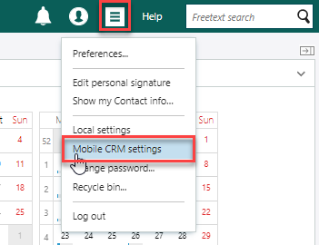
How to install SuperOffice Mobile CRM
Logg-in SuperOffice on your computer
Select “Mobile CRM settings” from the personal menu.

Slide 4
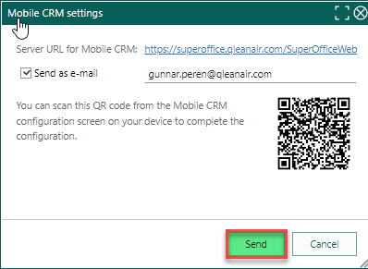
How to install SuperOffice Mobile CRM
Push send

Slide 5
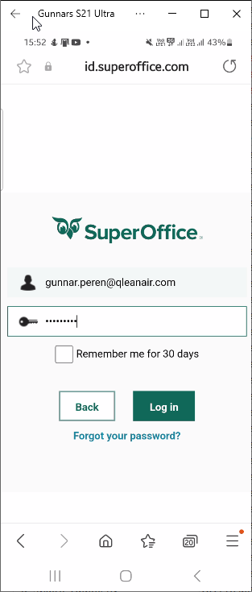
How to install SuperOffice Mobile CRM
Open mail from mobile
Follow the instructions & Log in

Slide 6
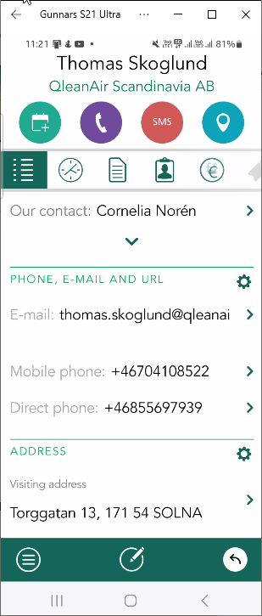
How to install SuperOffice Mobile CRM
DONE!

