Slide 1
SuperOffice & Trade Shows
How to do
Gunnar Peren CRM Manager

Slide 2
Why use SuperOffice for trade shows
Scan Business cards direct to SuperOffice CRM
Update CRM
Follow-up & emails
Report & analyse

Slide 3
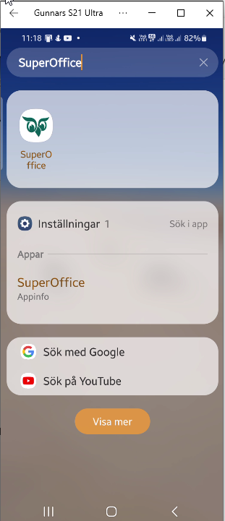
Scan business cards
Scan Business cards direct to SuperOffice CRM
Open
SuperOffice
on your phone

Slide 4
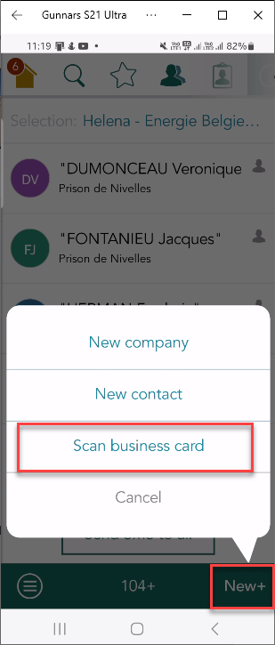
Scan business cards
Push “New+”
Scan business card

Slide 5
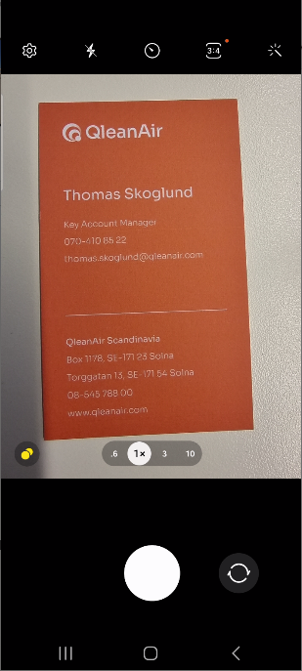
Scan business cards
Scan business card

Slide 6
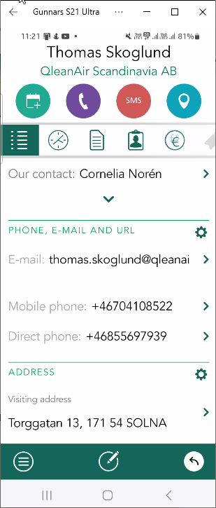
Scan business cards
Check that it has been done correctly

Slide 7
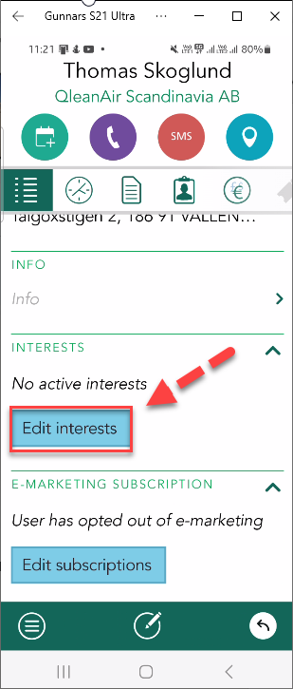
Update contact interest “ Trade Show”
Update interest in SuperOffice on your phone
Scroll down to
“Edit interests”

Slide 8
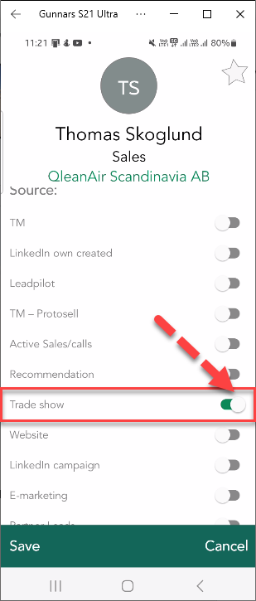
Update contact interest “ Trade Show”
Update interest in SuperOffice on your phone
Update
“Trade show”

Slide 9
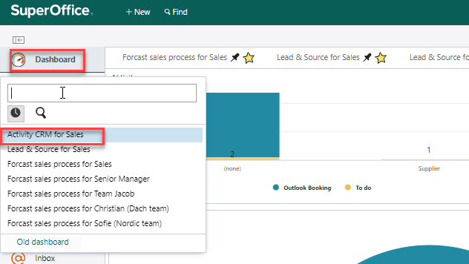
How to link a trade leads to Selection or Project

