Slide 2
CRM Training
How to do a proposal/quote in SuperOffice

Slide 3
Part one:
To create a new proposal/quote
Part two:
Link a previously made quote that isn't saved in SuperOffice CRM.

Slide 4
PART ONE : I make a new proposal
  Update the correct data fields in SuperOffice Sales:
    Sales date – Update when you believe the contract will be signed (order date)
    Total value – Update the total value in the Sales Opportunity
    Change Stage – Change stage to Offer a Presentation
    Business Area – Update Business Area
    Type of unit – Is it a new or existing etc
  Proposal shall be made and saved in SuperOffice!
  If a “New unit”
    Do forecasting for Product management!

Slide 5






I make a new proposal – Process description
1
2
3
4
5
6
Sales Date:
Sales Sum:
Type of unit:
Business Area:
Create the Proposal:
Sales tab
Sales tab
Sales tab
Sales tab
Quote tab
Send the Proposal
When do you believe it will be closed (signed contract received)?
What do you believe the total sum will be?
Update
Update
Update
Update
Create
7
8
Product Name
& Number of units
If “New unit” – Do product forecasting!
Quote tab – Add product – Search & update
Quote tab
Create
Create

Slide 6
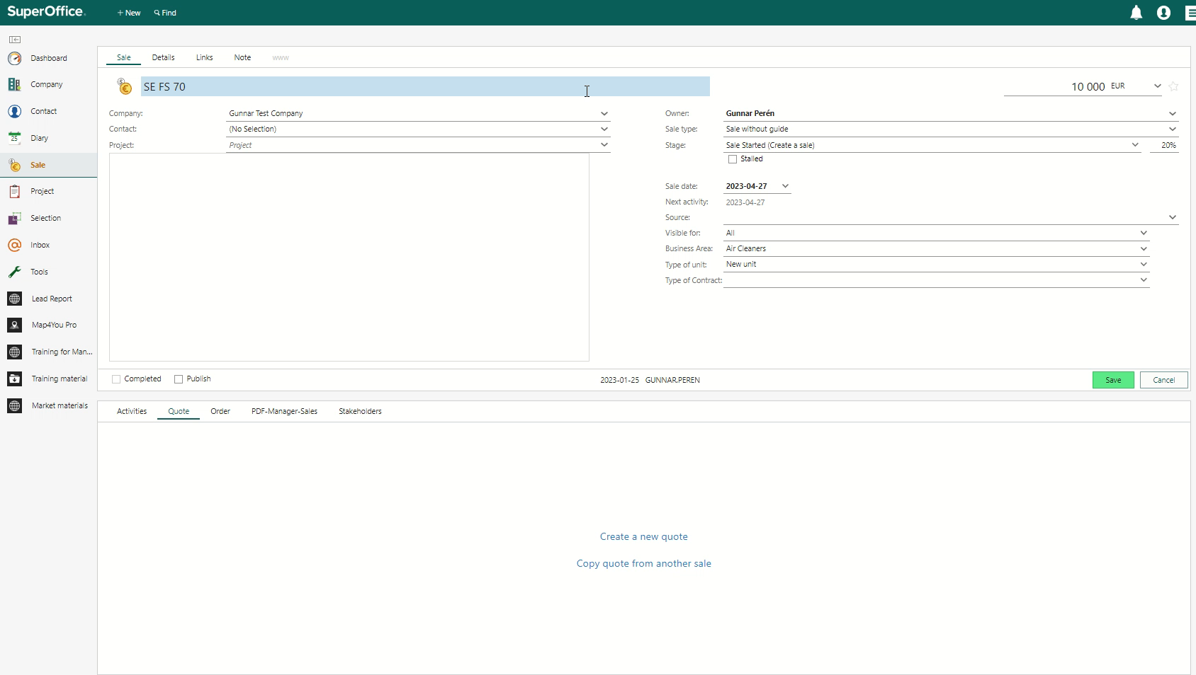
I do a proposal -Short movie (klick to start)

Slide 7
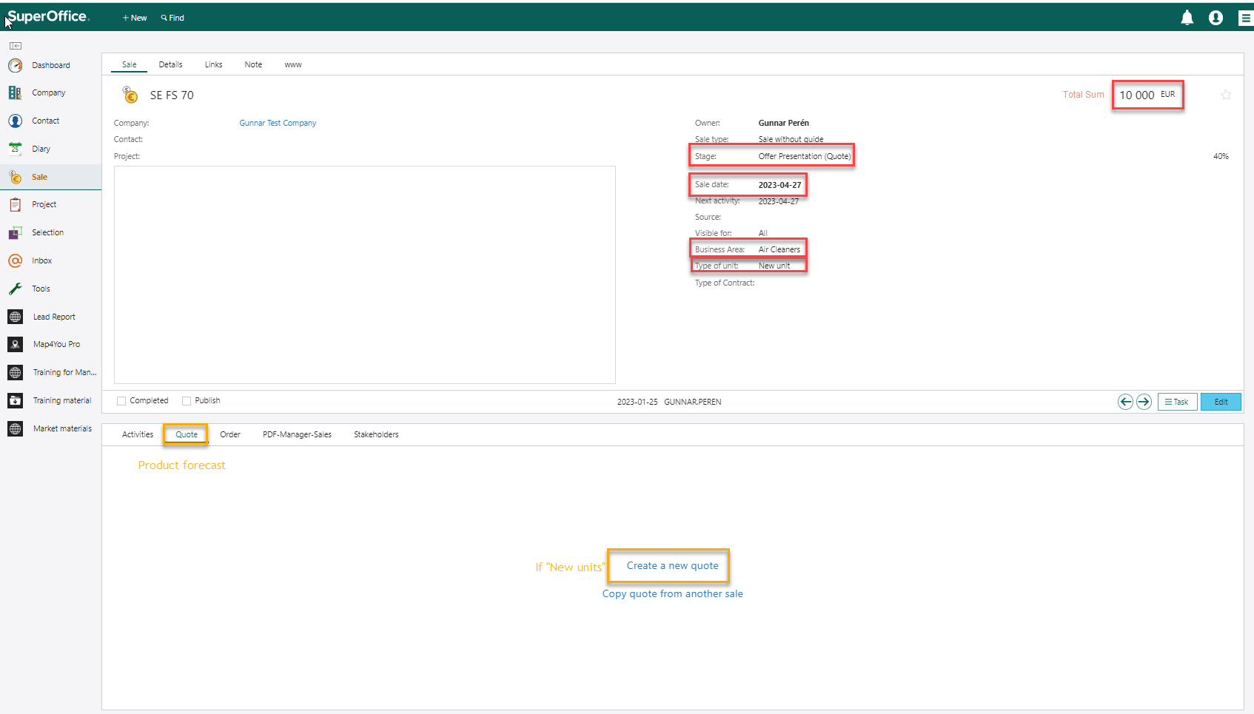
2 – I make a proposal – Step by step
Update
Update
Update
Update
Update

Slide 8
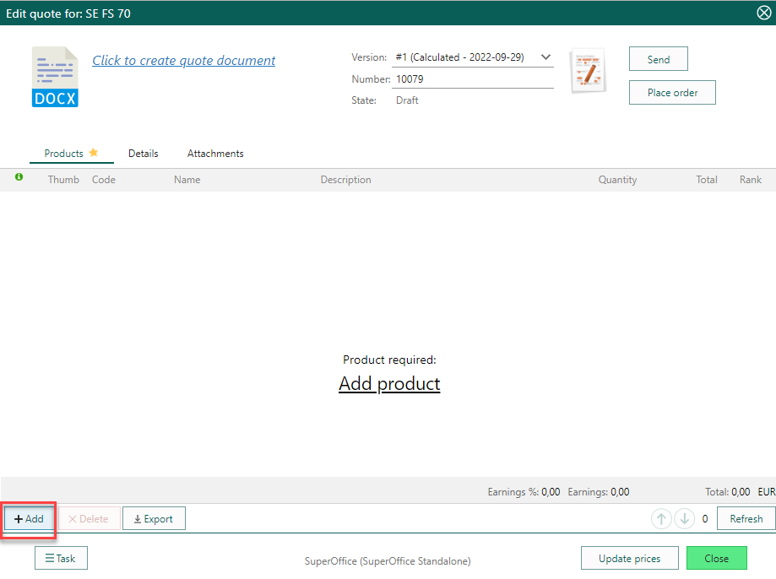
I do a proposal - Step by step
2 – Create a Proposal
Forecast – If a new unit
Add Product
Click

Slide 9
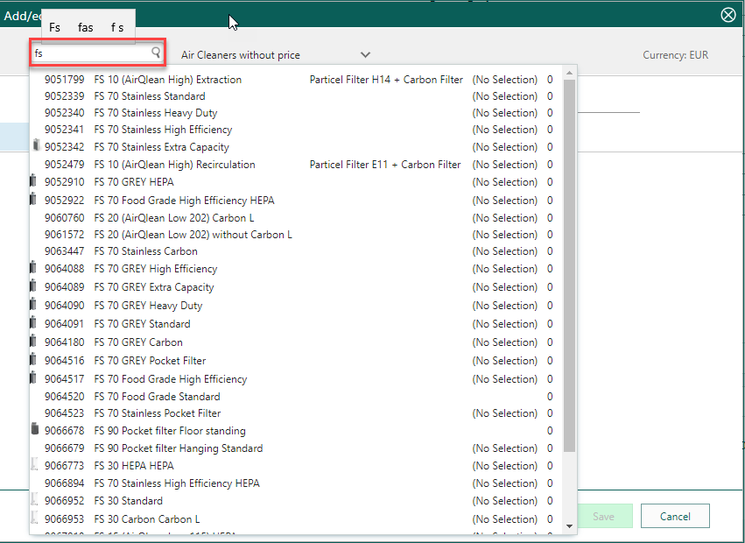
I do a proposal - Step by step
2 – Create a Proposal
Forecast – If a new unit
Add Product
Search product
Don’t need to ad add-ones
Update Unit

Slide 10
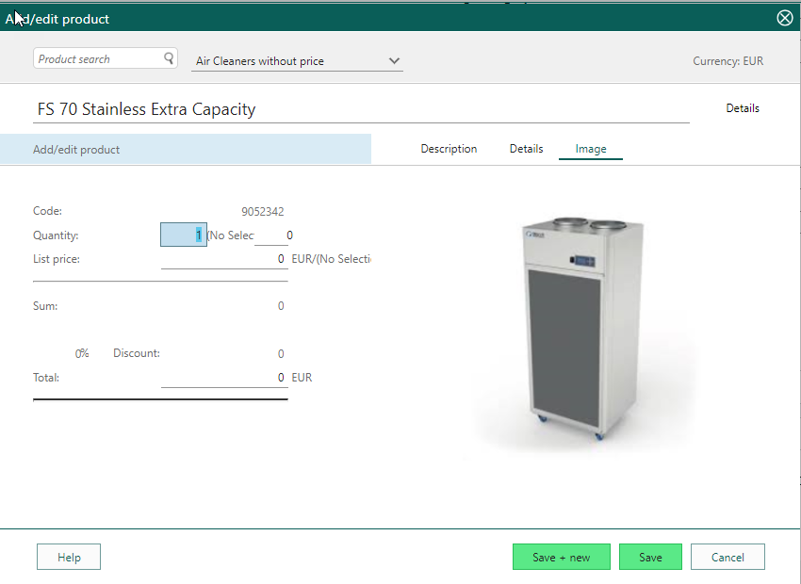
I do a proposal - Step by step
2 – Create a Proposal
Forecast – If a new unit
Add – Add Product
Search product
Don’t need to ad add-ones
Quantity
How many?

Slide 11
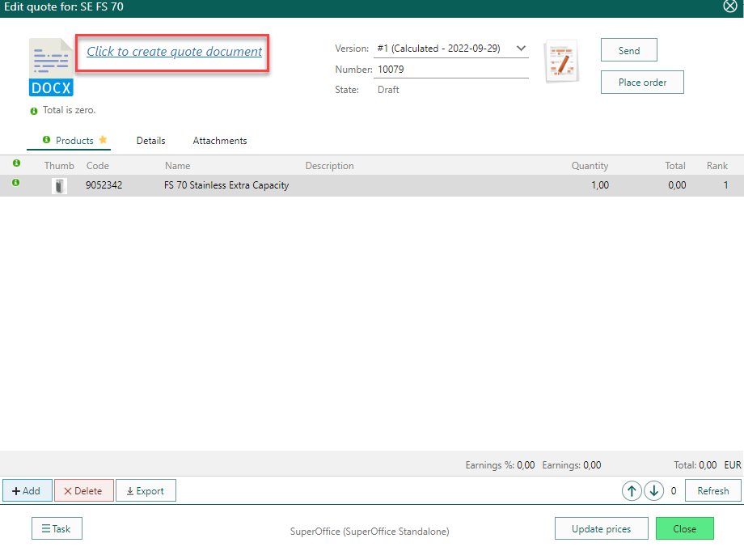

I do a proposal - Step by step
2 – Create a Proposal
Forecast – If a new unit
Add – Add Product
Search product
Don’t need to ad add-ones
Quantity
Create quote document –
(You can also create the Quote from her)
Click
Don’t push!

Slide 12
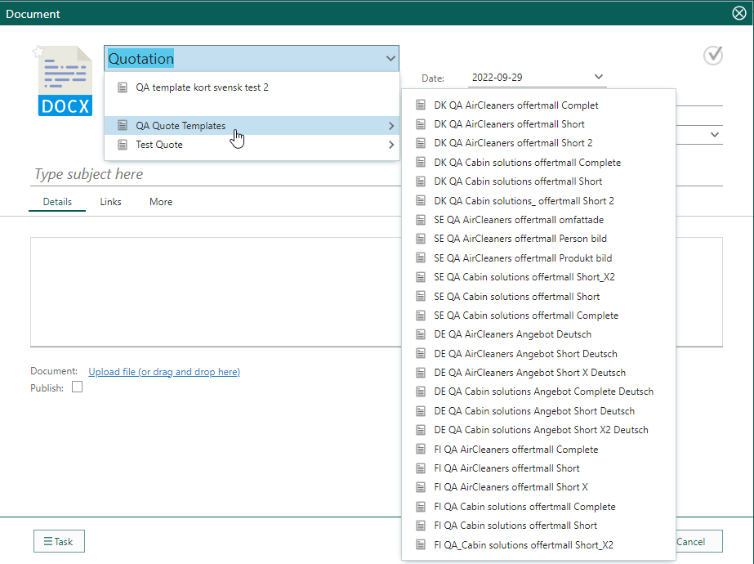
I do a proposal - Step by step
2 – Create a Proposal
Forecast – If a new unit
Add – Add Product
Search product
Don’t need to ad add-ones
Quantity
Create quote document –
(You can also create the Quote from her)

Slide 13
Part one:
To create a new proposal/quote
Part two:
Link a previously made quote that isn't saved in SuperOffice CRM.

Slide 14
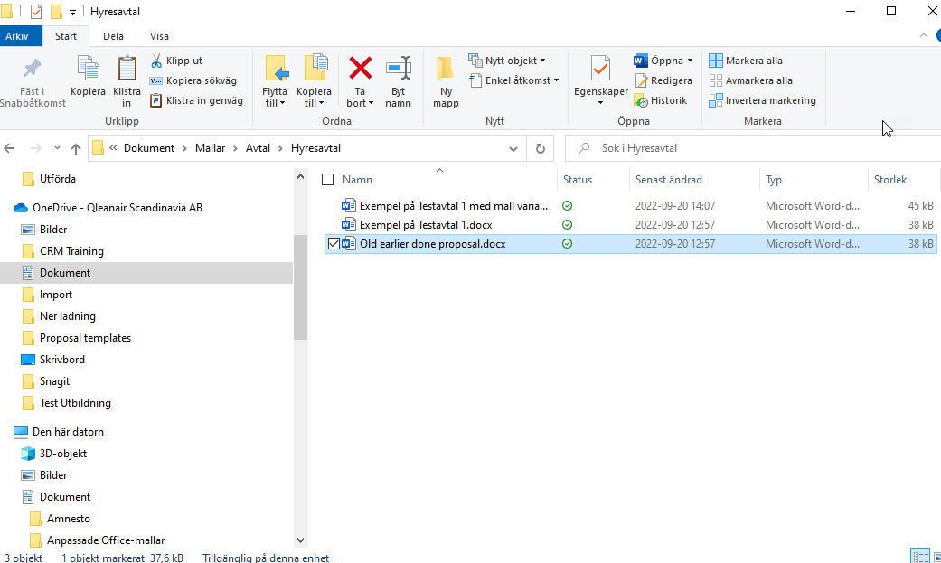
Find earlier done proposal

Slide 15
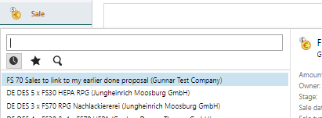
Find Sale in SuperOffice where you wish to save the proposal

Slide 16
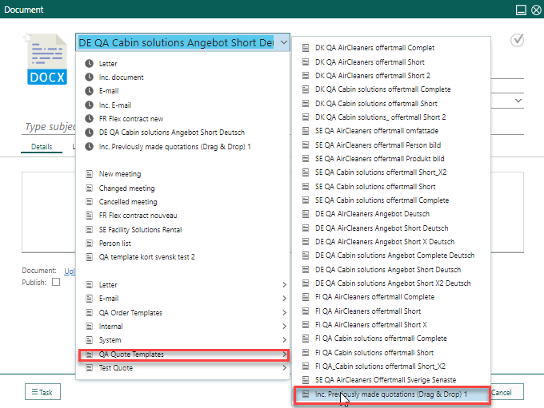
Create a new document but choose “ Inc. Previously made quotations”

Slide 17
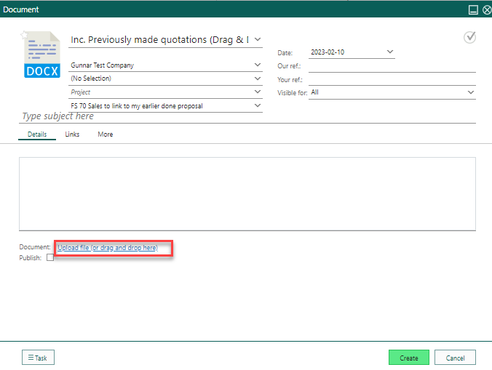
Upload (click) or drag and drop it

Slide 18
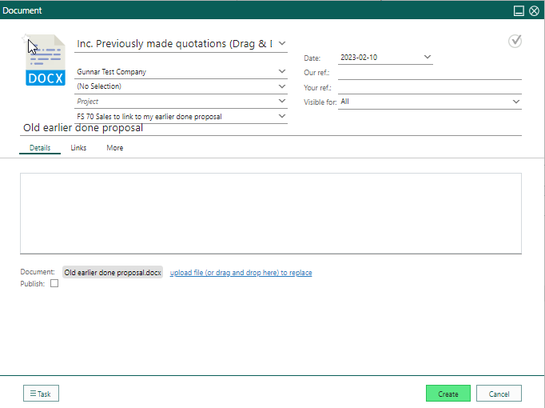
Upload (click) or drag and drop it - Create and its done!

Slide 19


